Slide 1
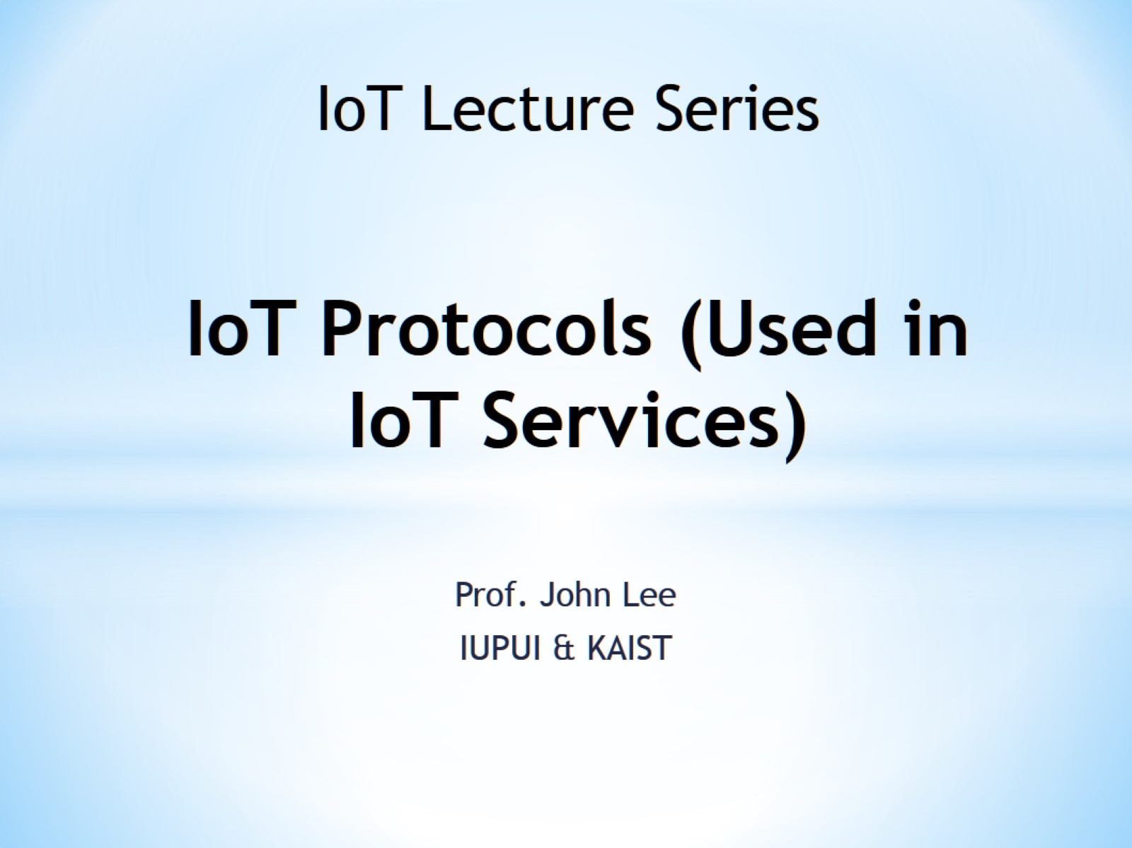
IoT Protocols (Used in IoT Services)

Slide 2
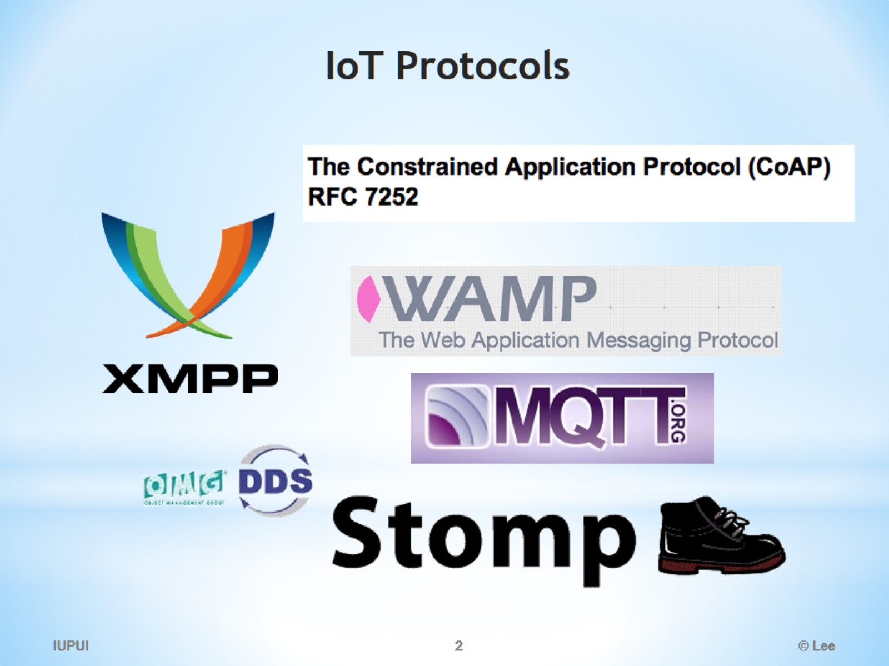
IoT Protocols

Slide 3
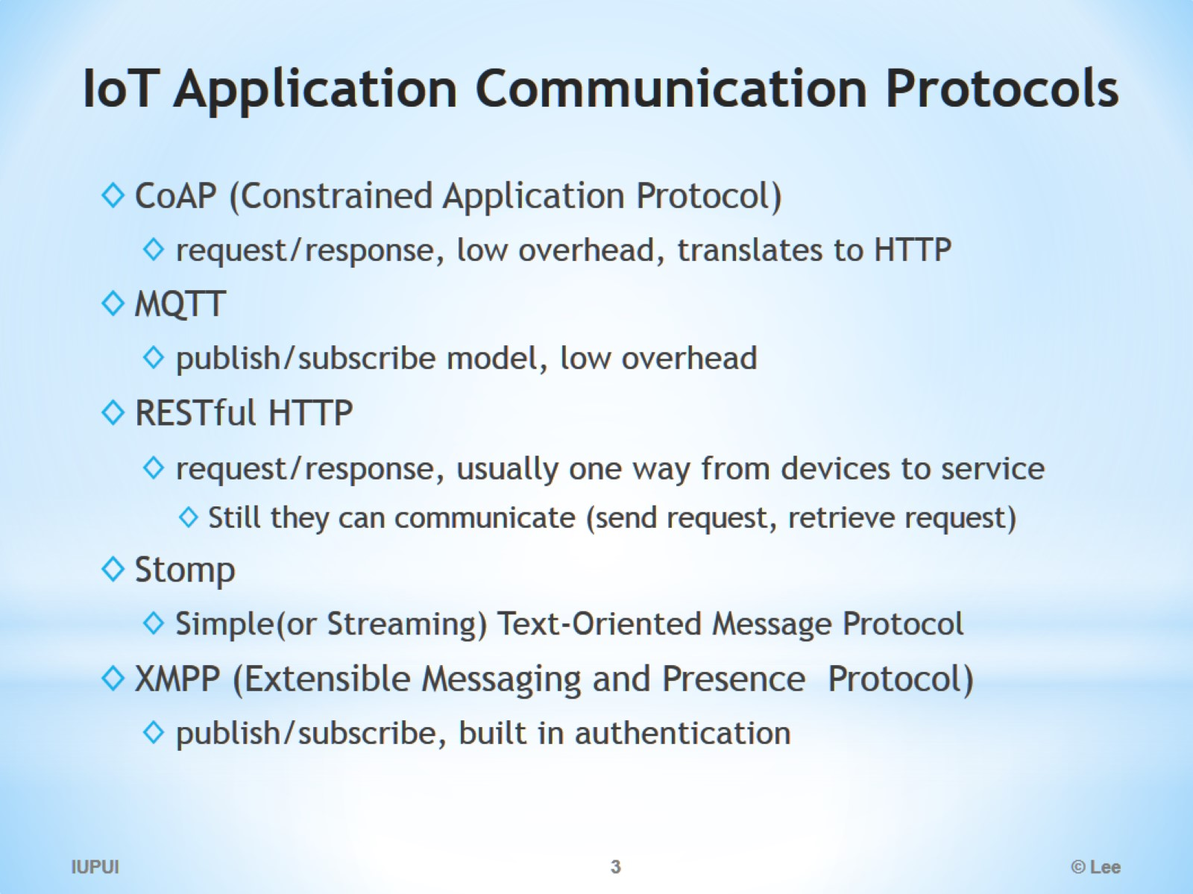
IoT Application Communication Protocols

Slide 4
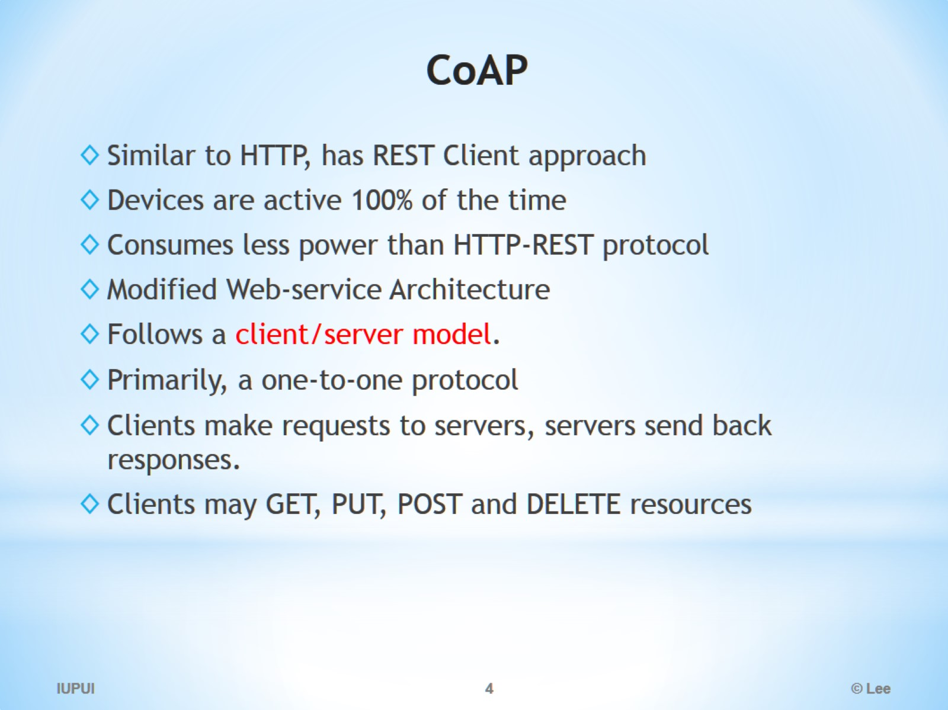
CoAP

Slide 5
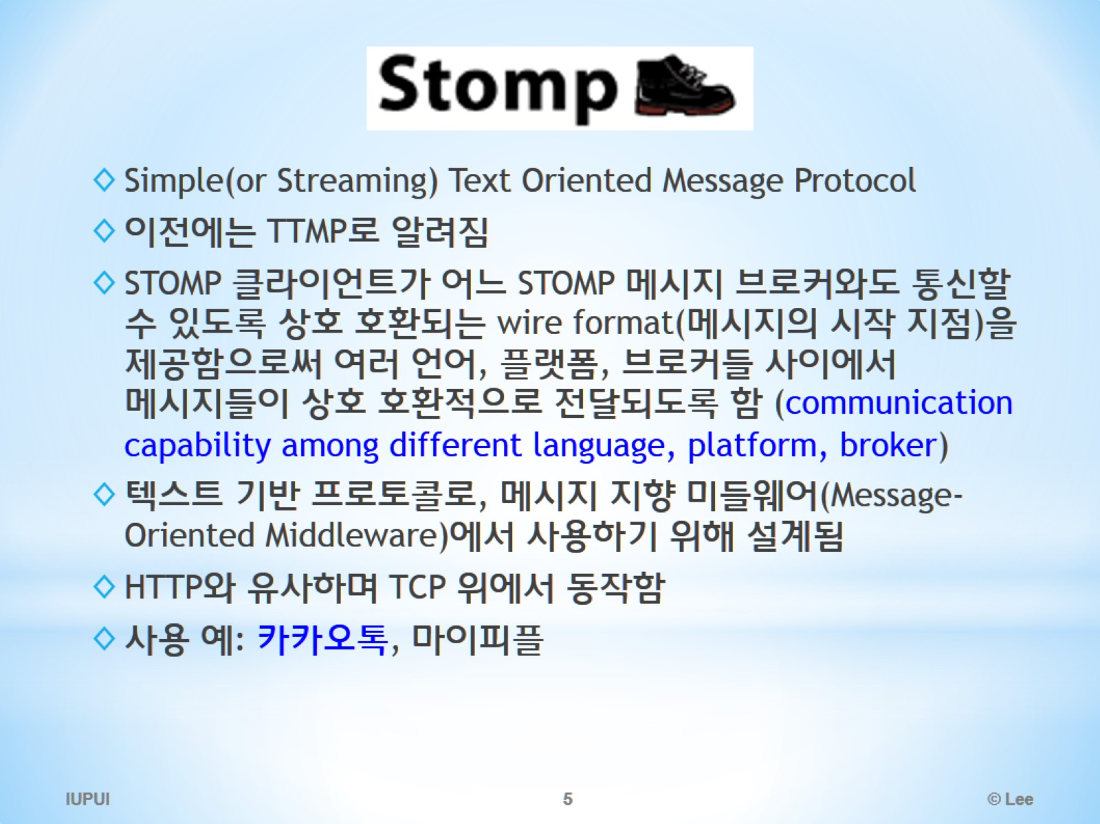
Stomp

Slide 6
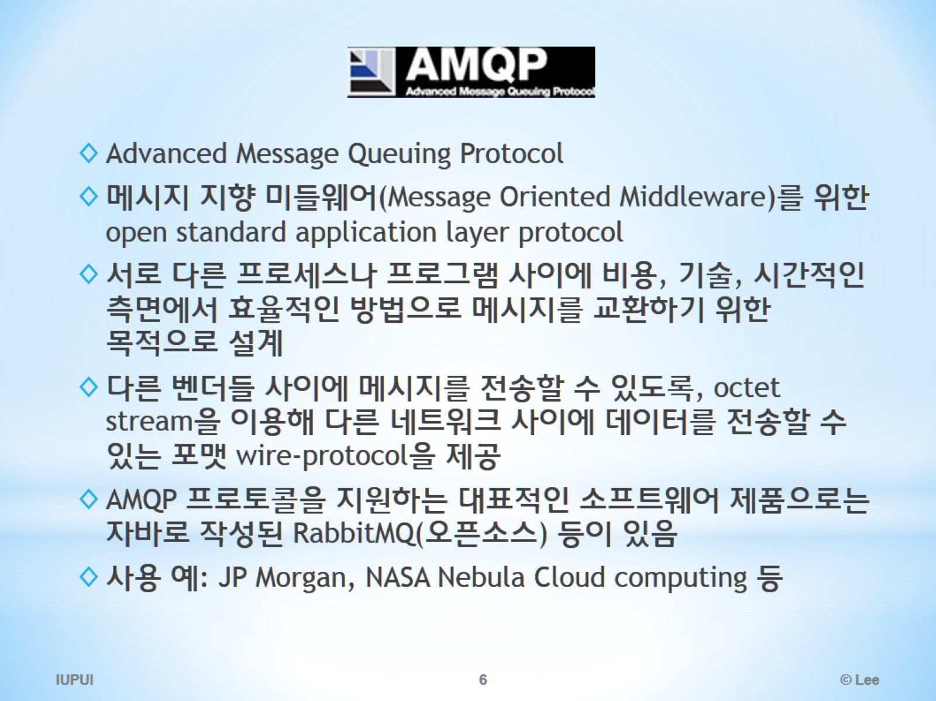
므뼤

Slide 7
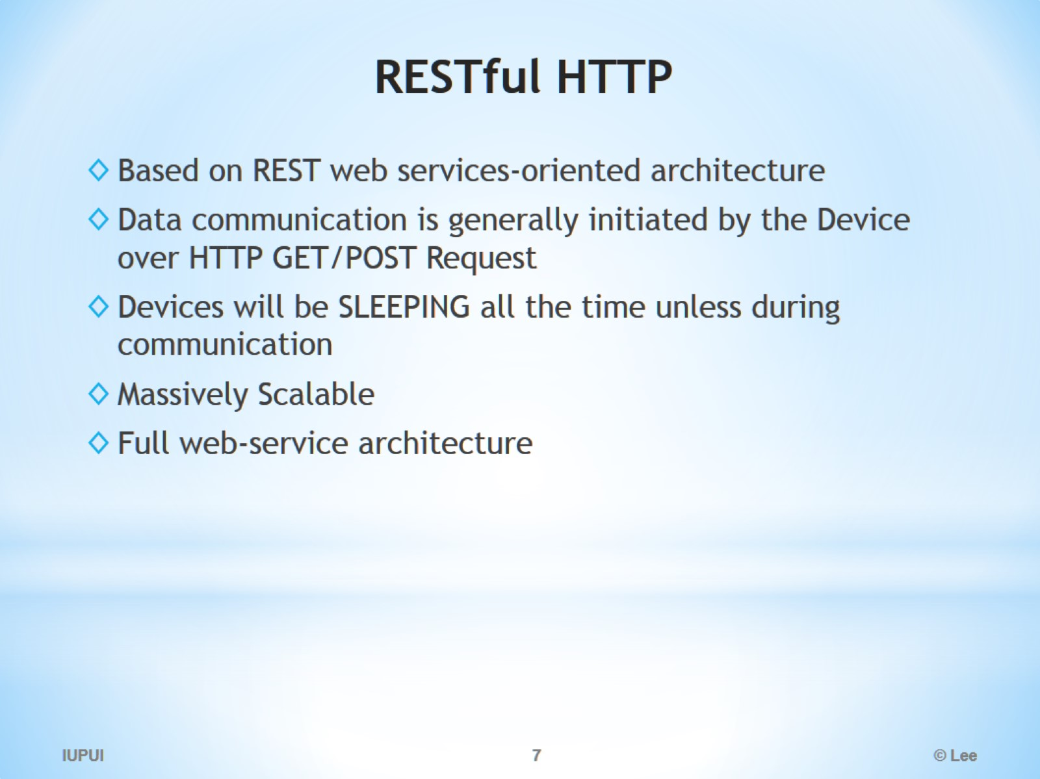
RESTful HTTP

Slide 8
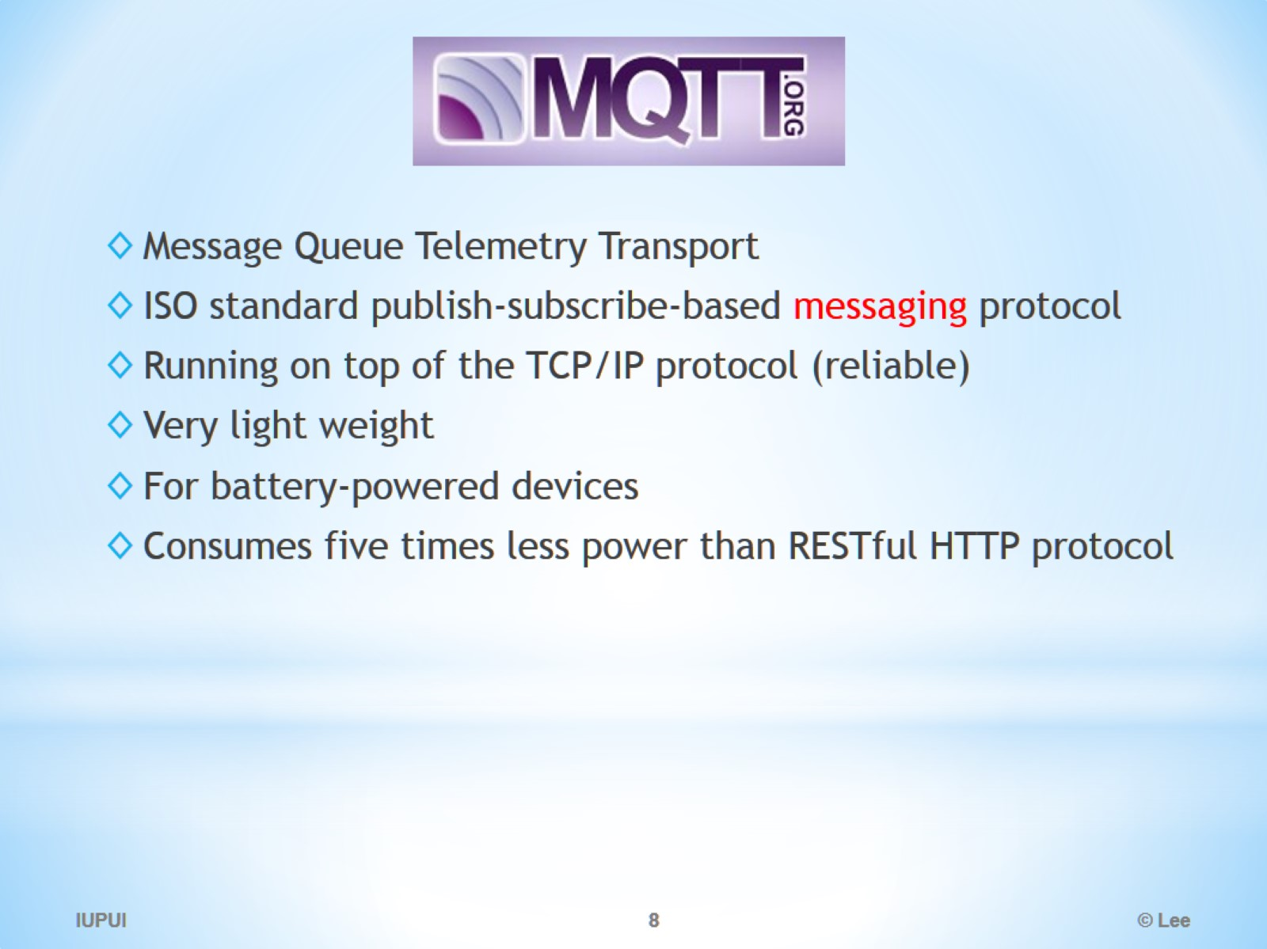
MQTT

Slide 9
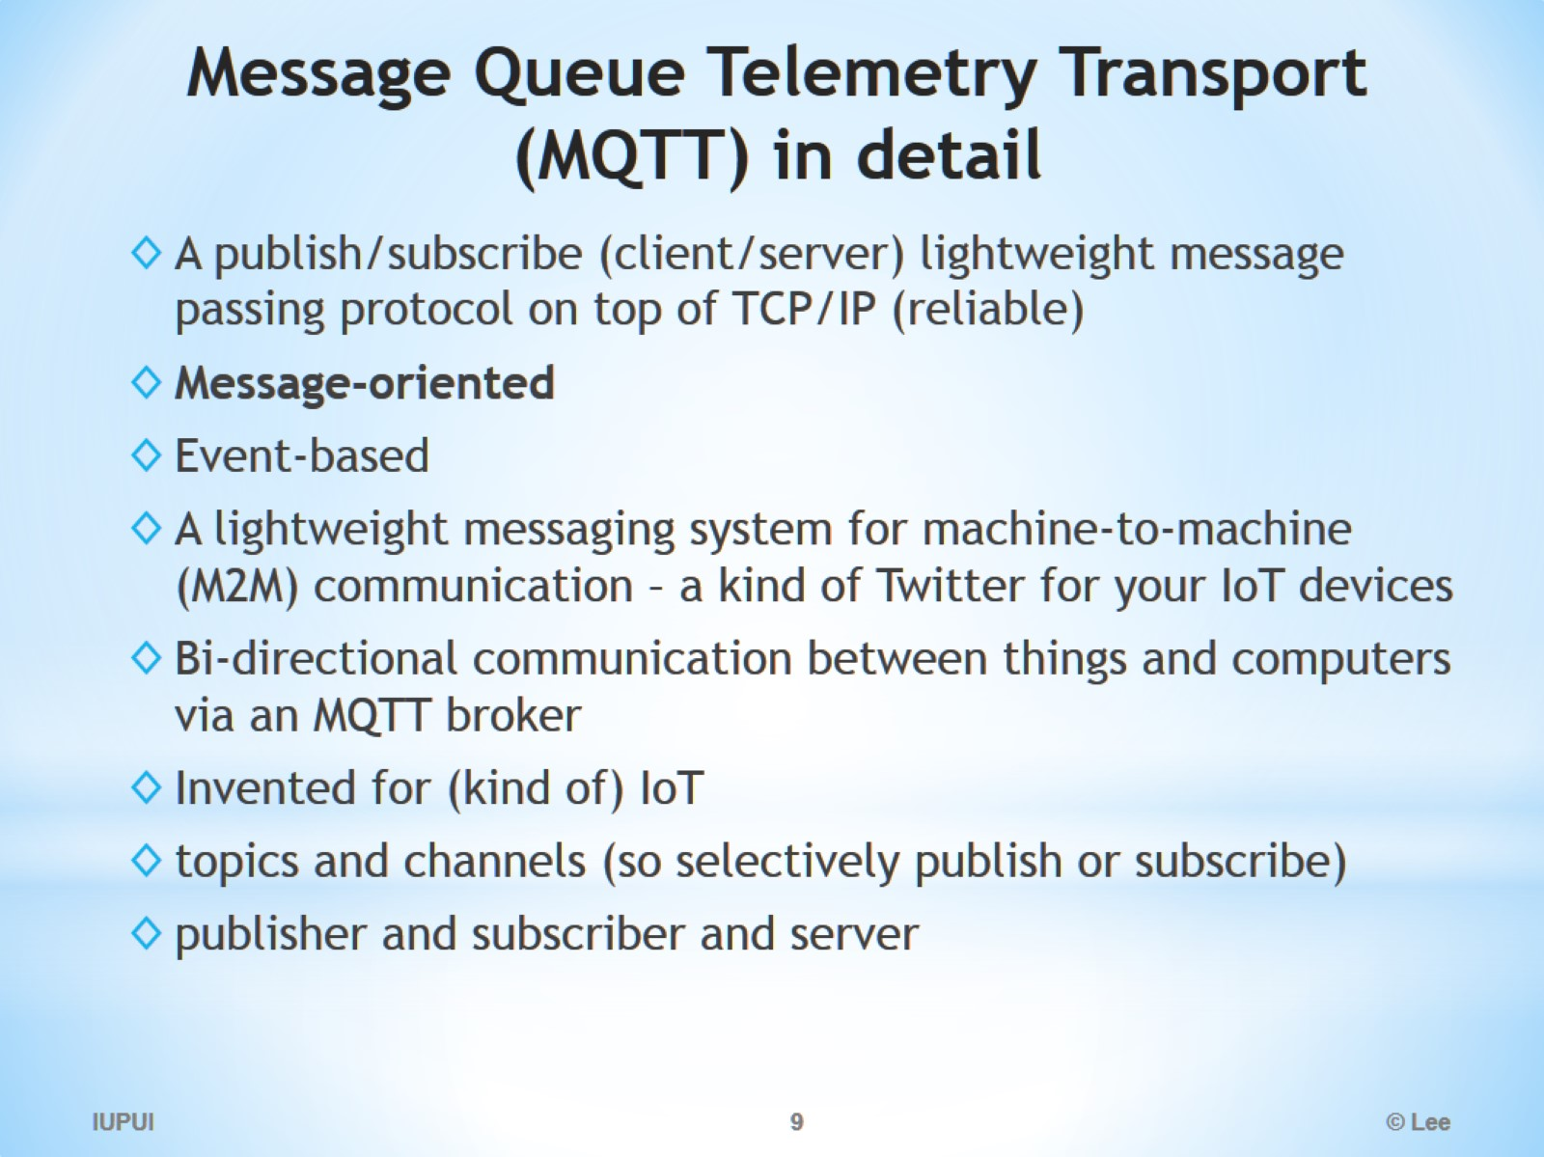
Message Queue Telemetry Transport (MQTT) in detail

Slide 10
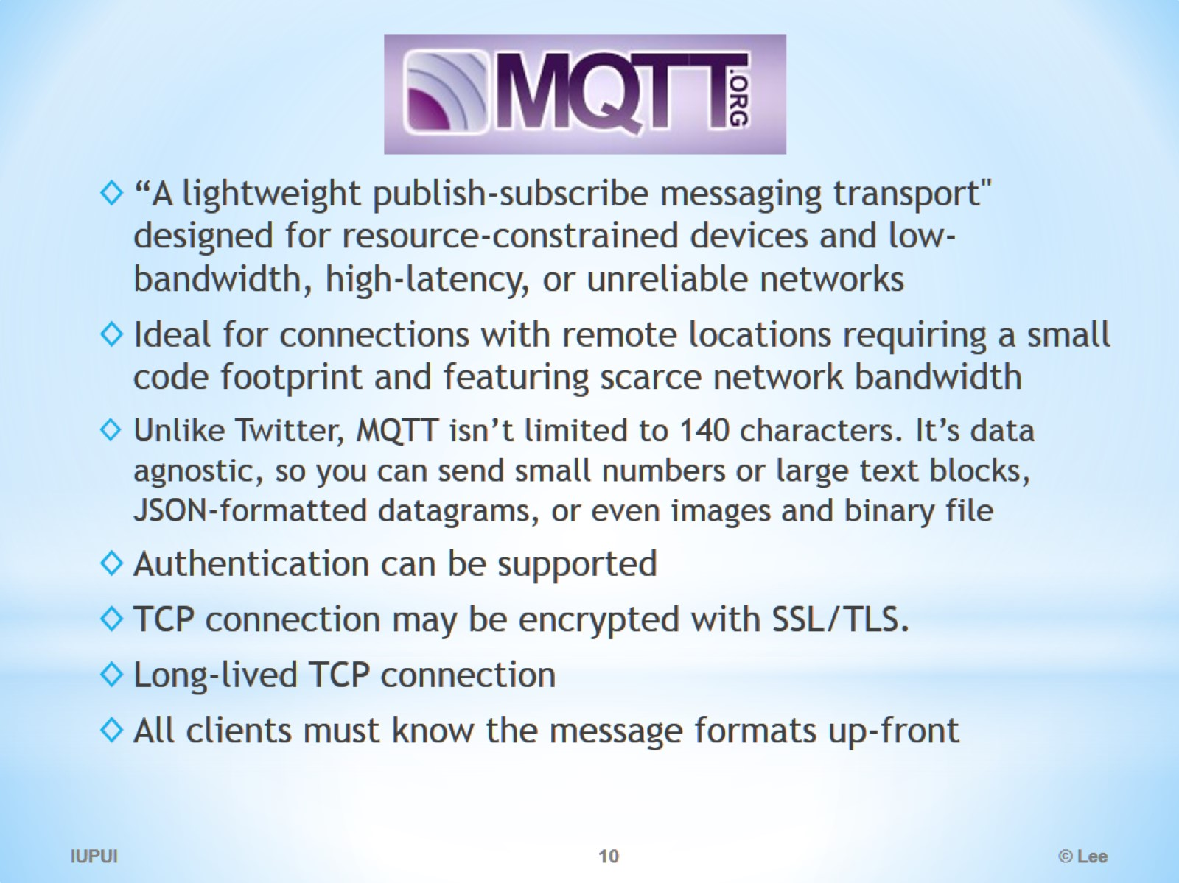
MQTT

Slide 11
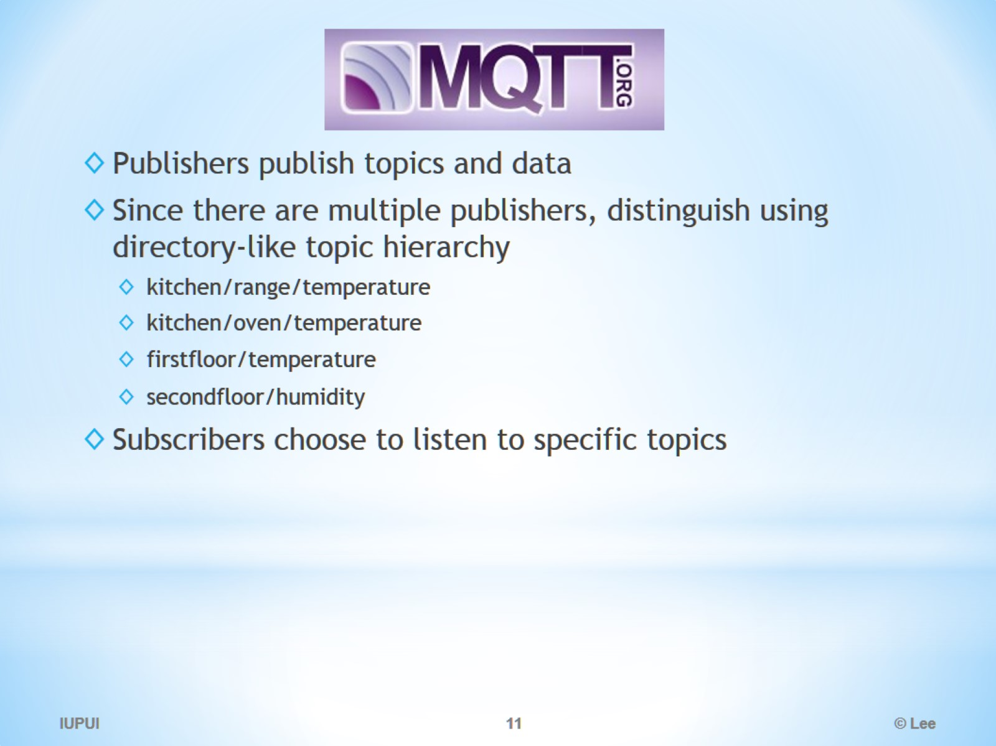

Slide 12
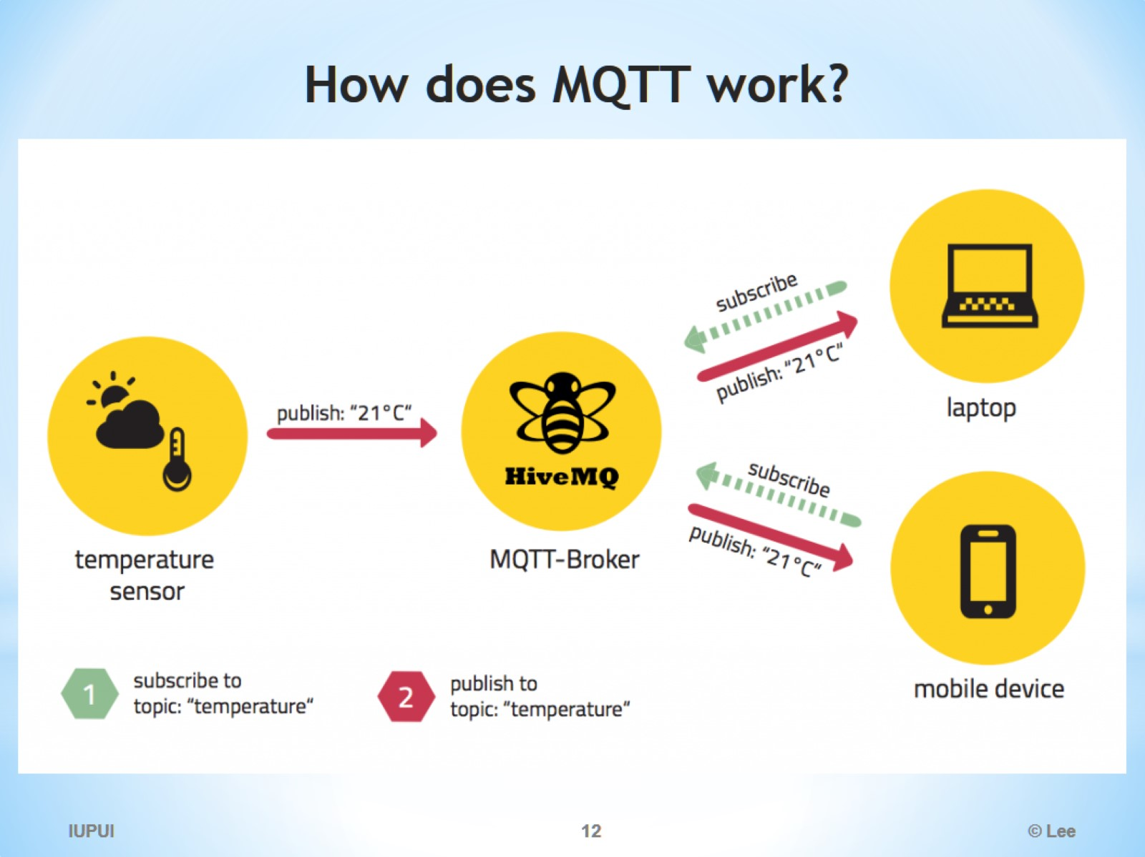
How does MQTT work?

Slide 13
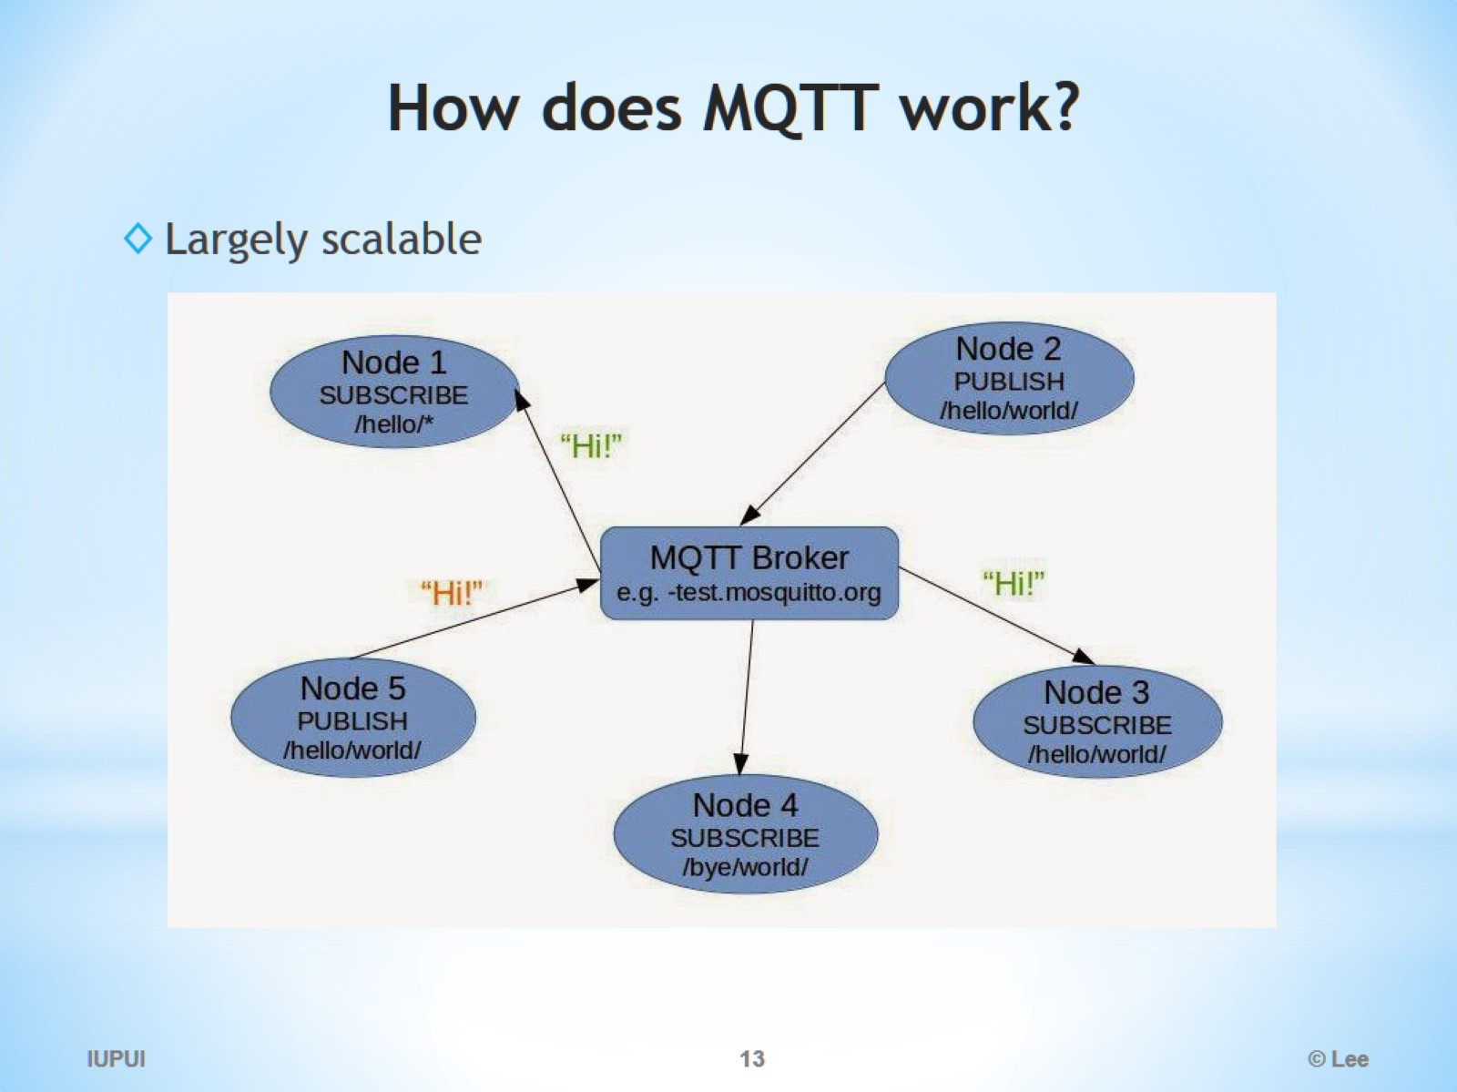
How does MQTT work?

Slide 14
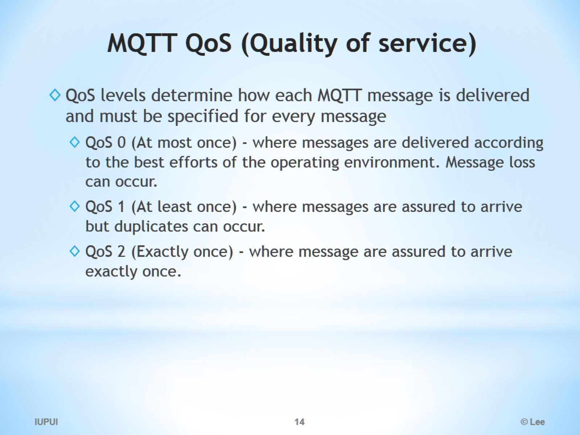
MQTT QoS (Quality of service)

Slide 15
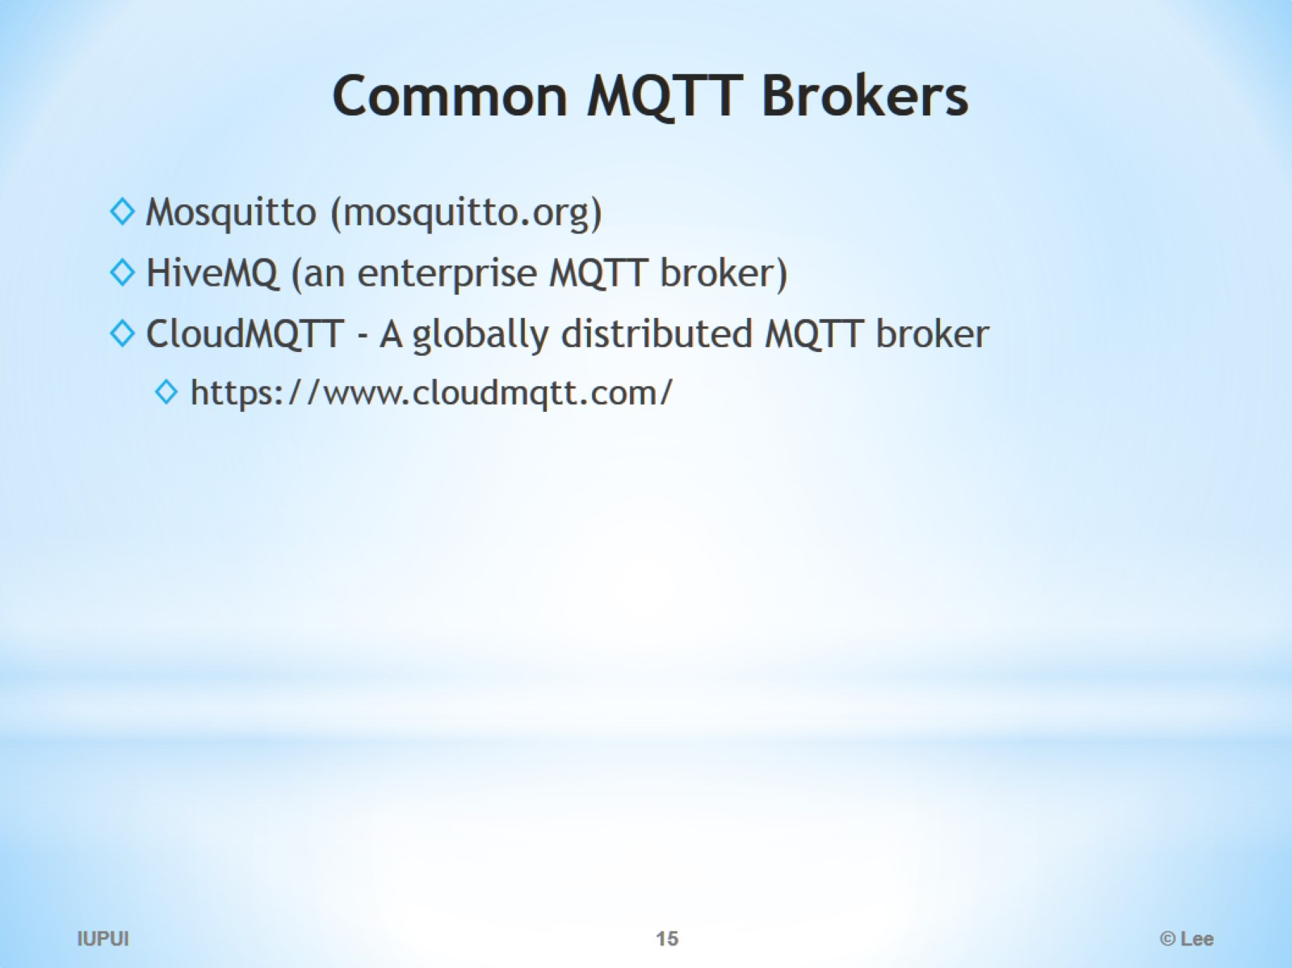
Common MQTT Brokers

Slide 16
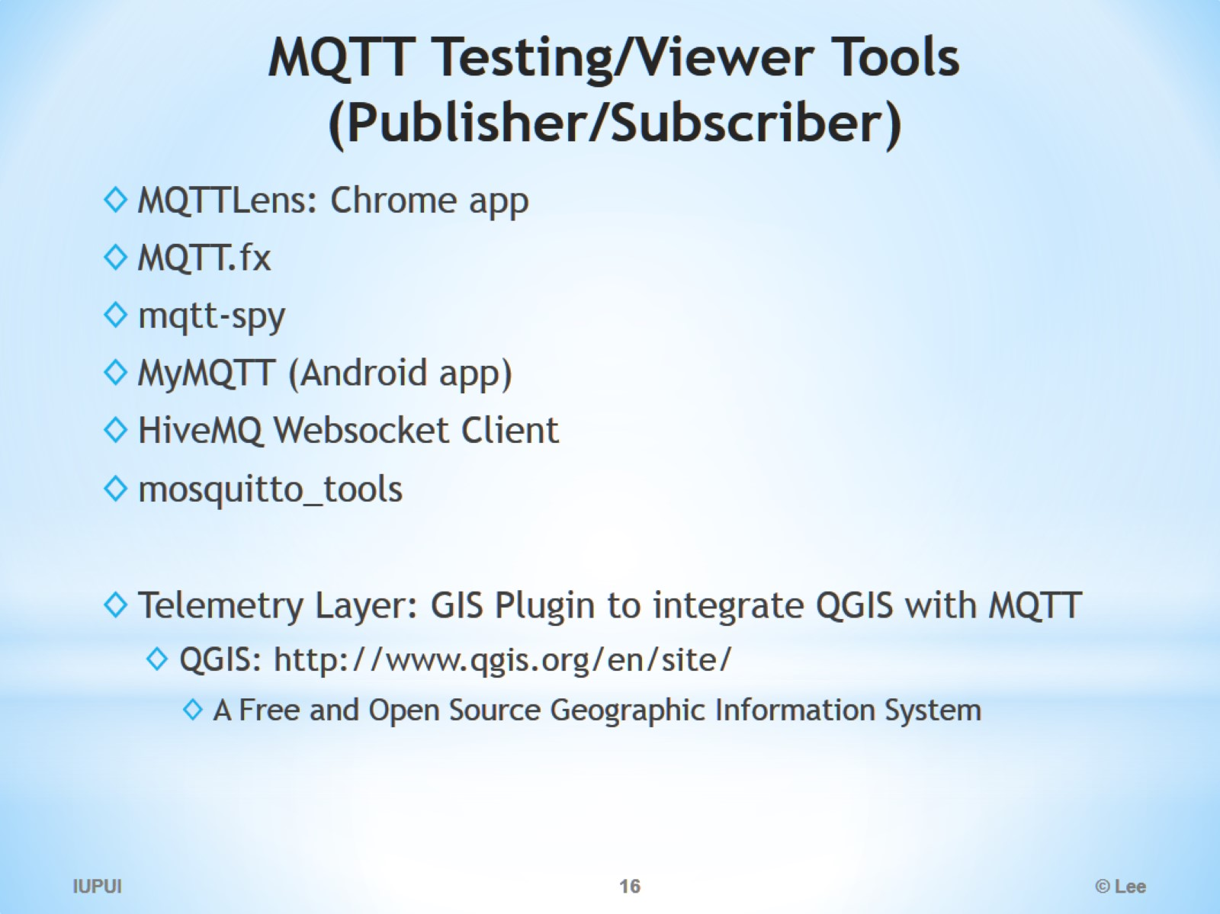
MQTT Testing/Viewer Tools (Publisher/Subscriber)

Slide 17
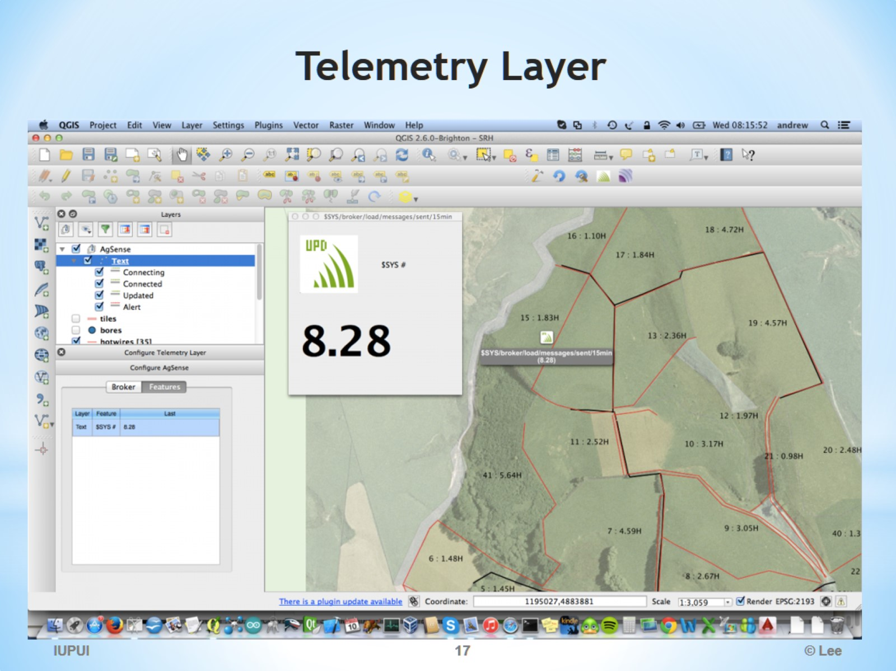
Telemetry Layer

Slide 18
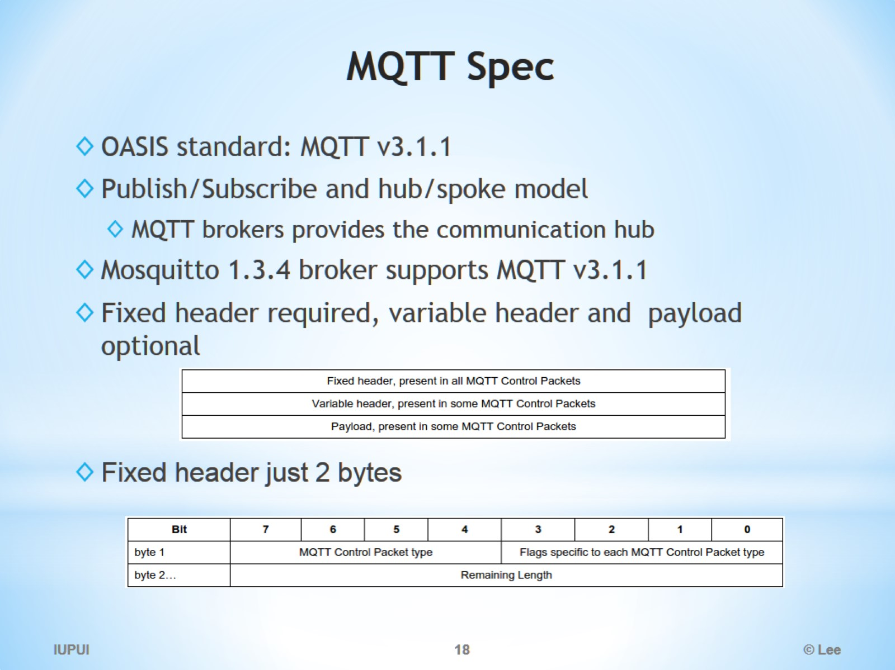
MQTT Spec

Slide 19
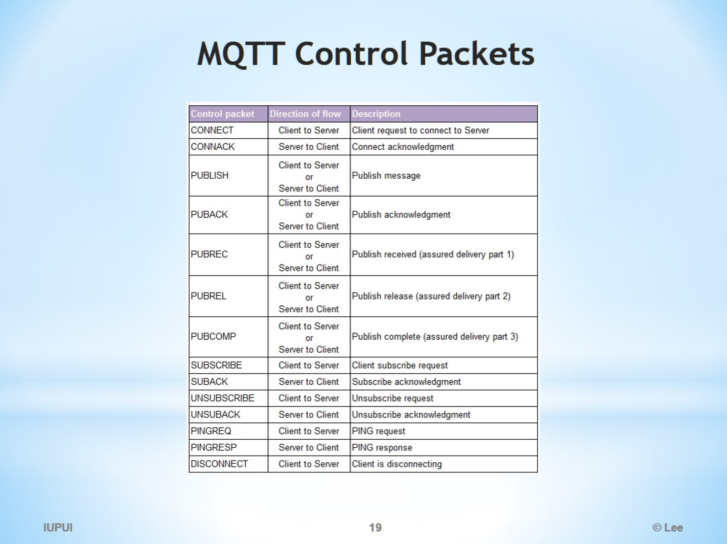
MQTT Control Packets

Slide 20
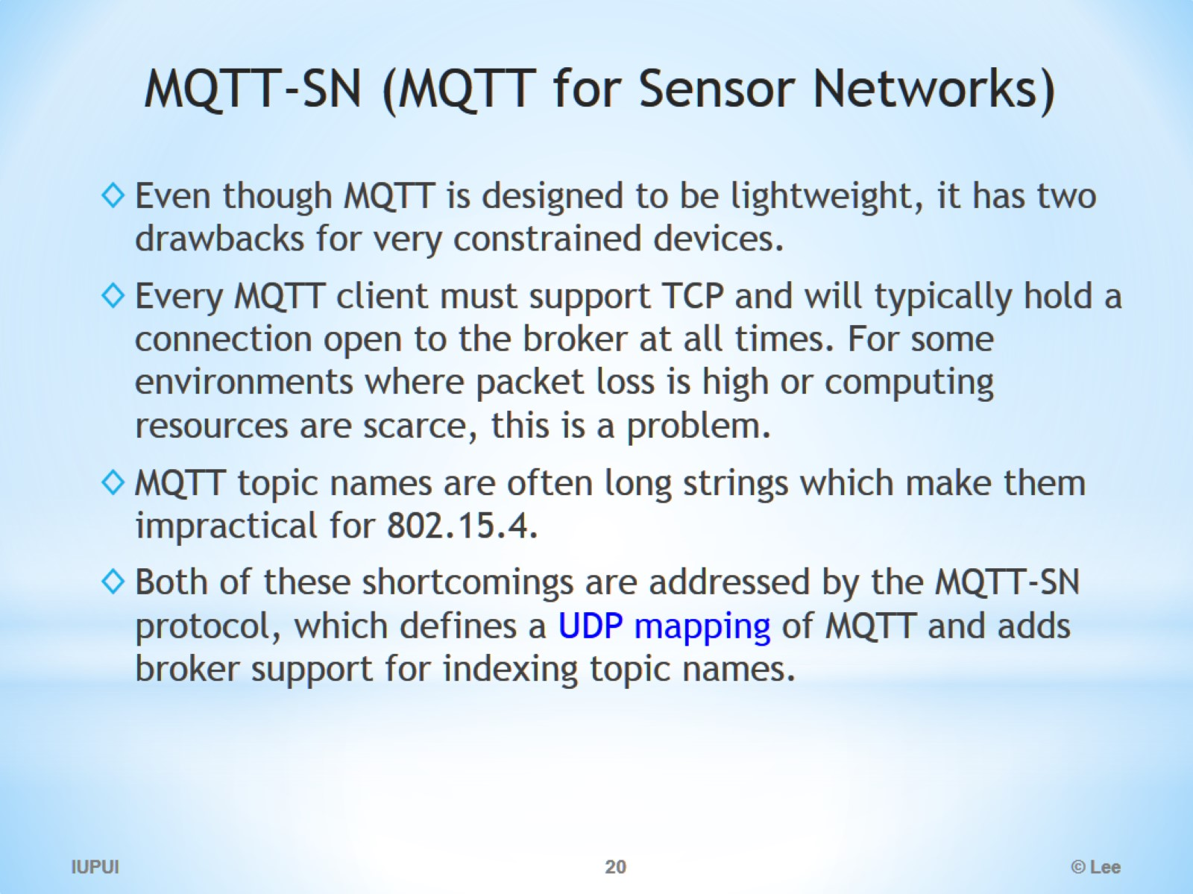
MQTT-SN (MQTT for Sensor Networks)

Slide 21
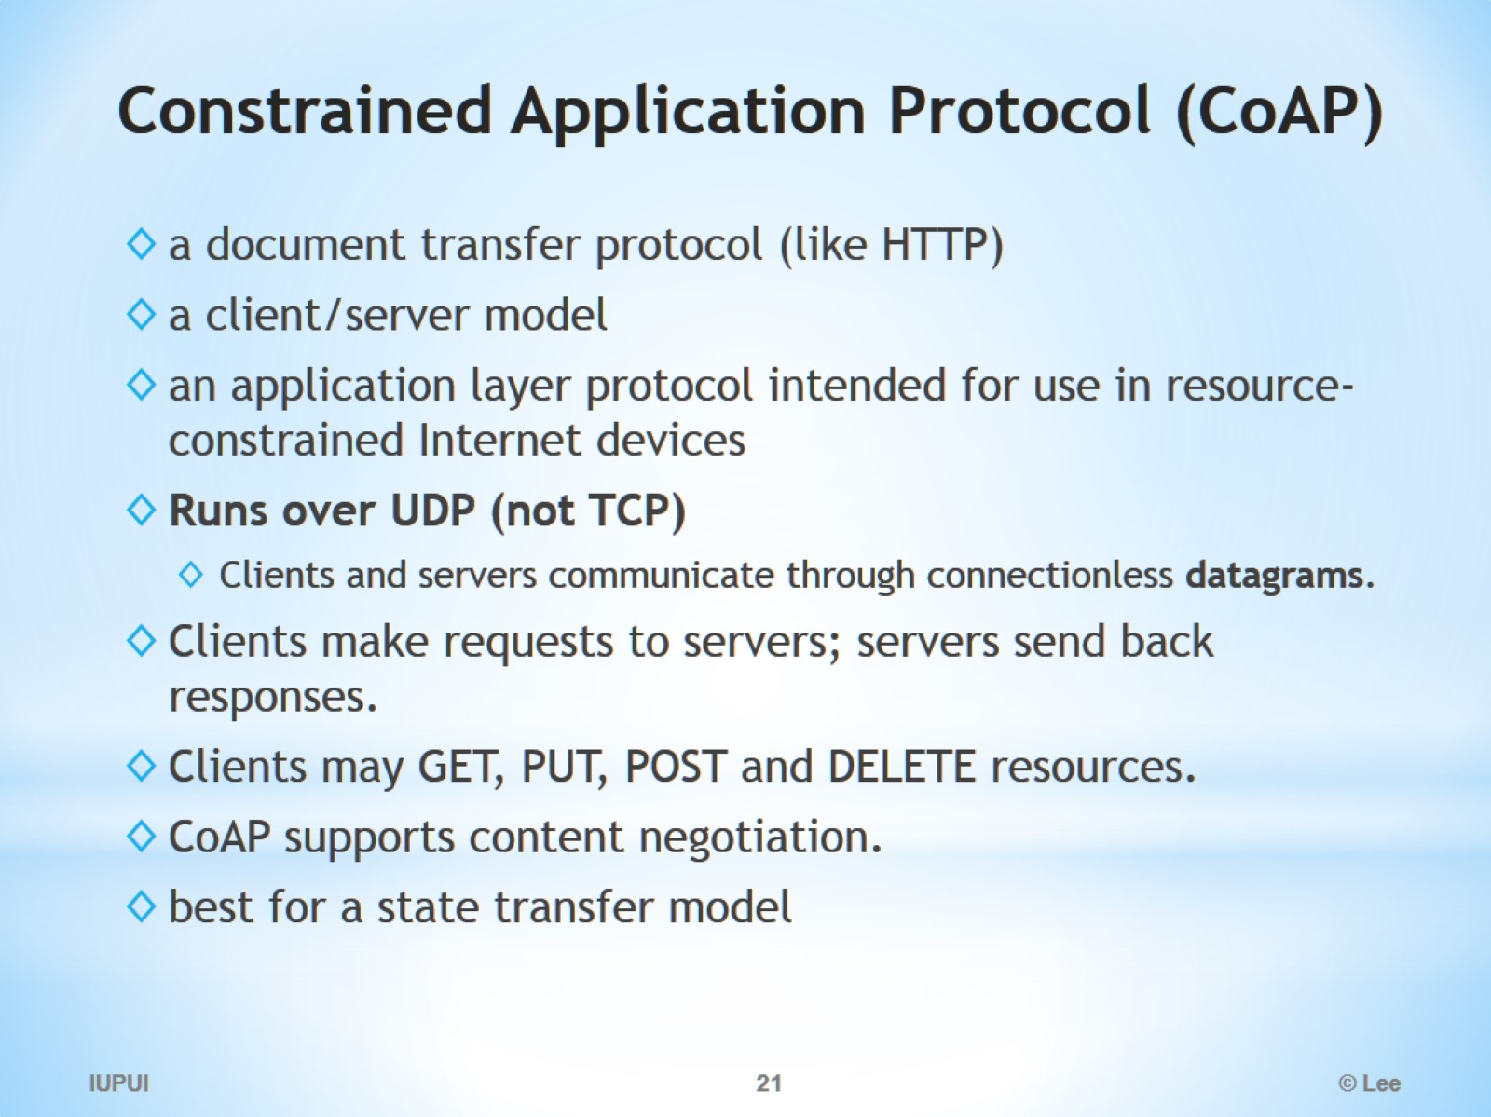
Constrained Application Protocol (CoAP)

Slide 22
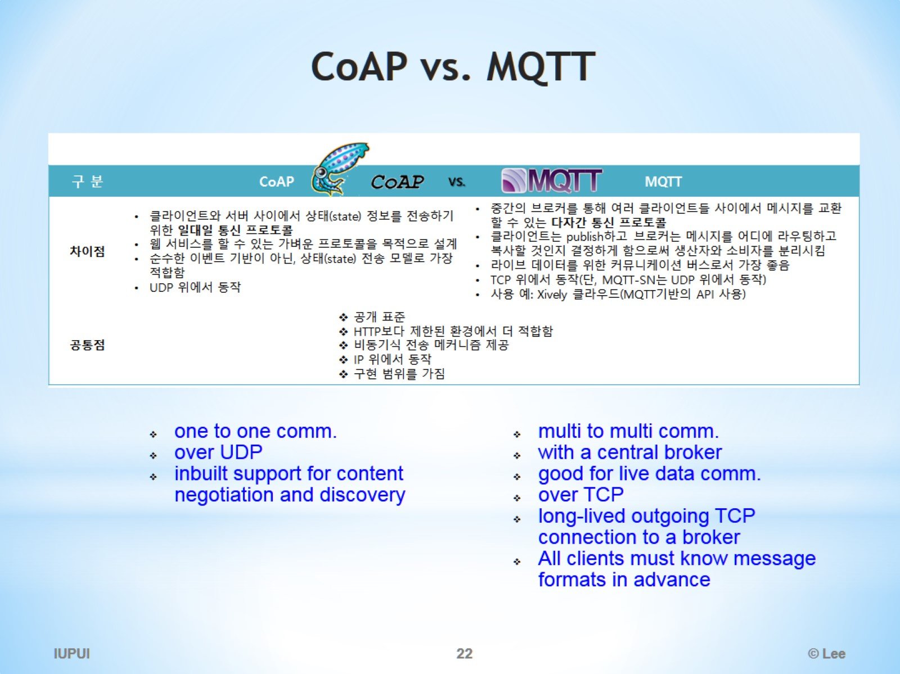
CoAP vs. MQTT

Slide 23
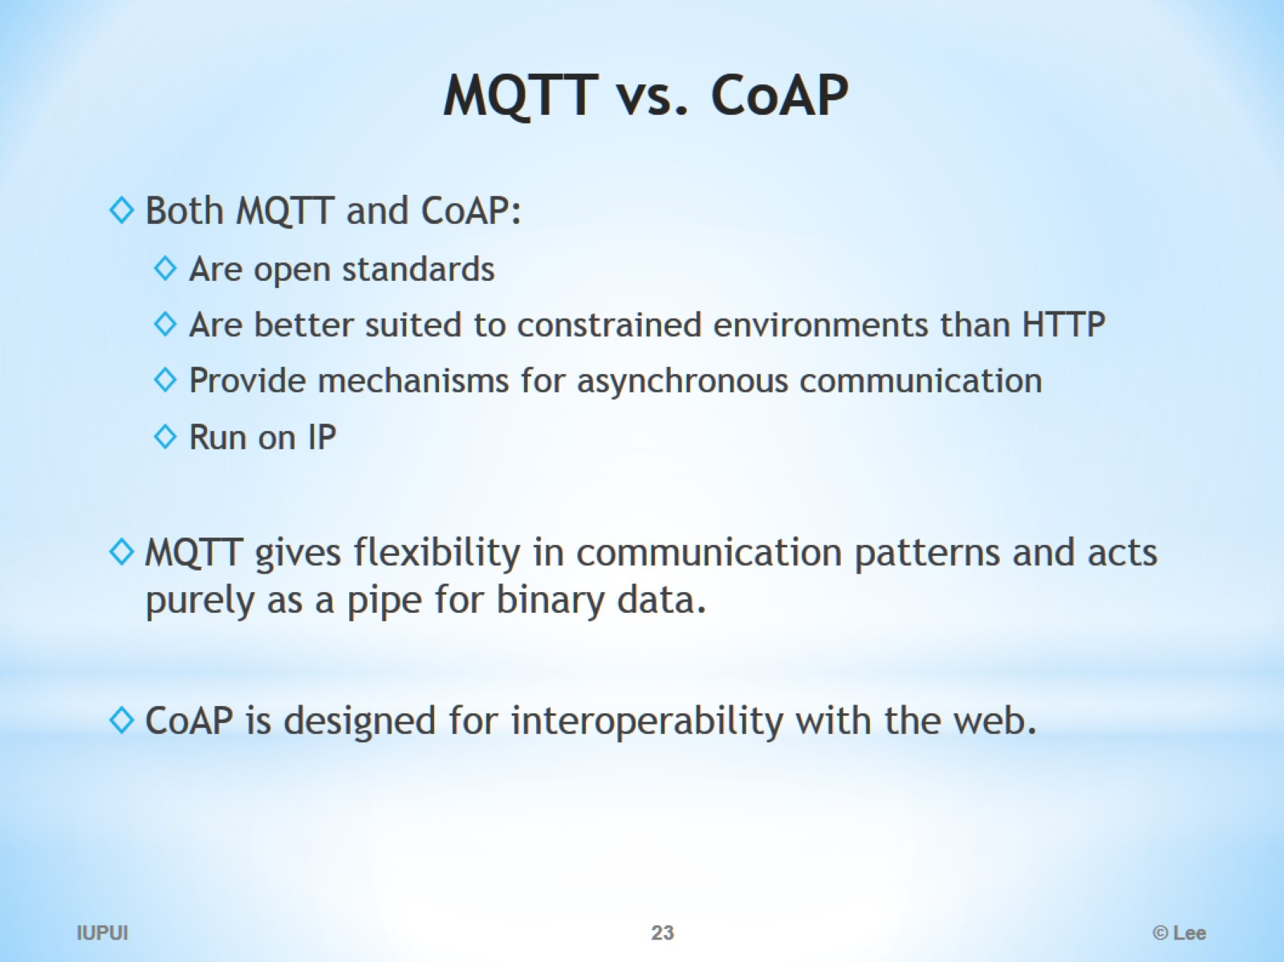
MQTT vs. CoAP

Slide 24
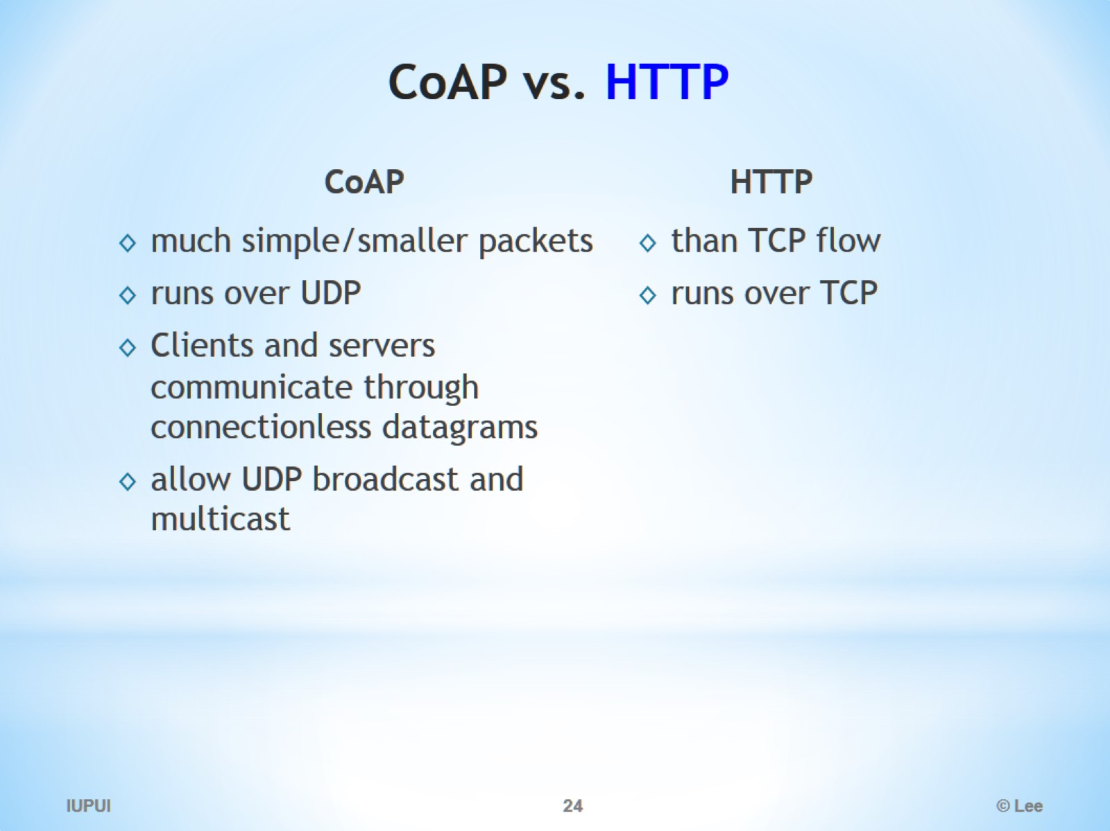
CoAP vs. HTTP

Slide 25
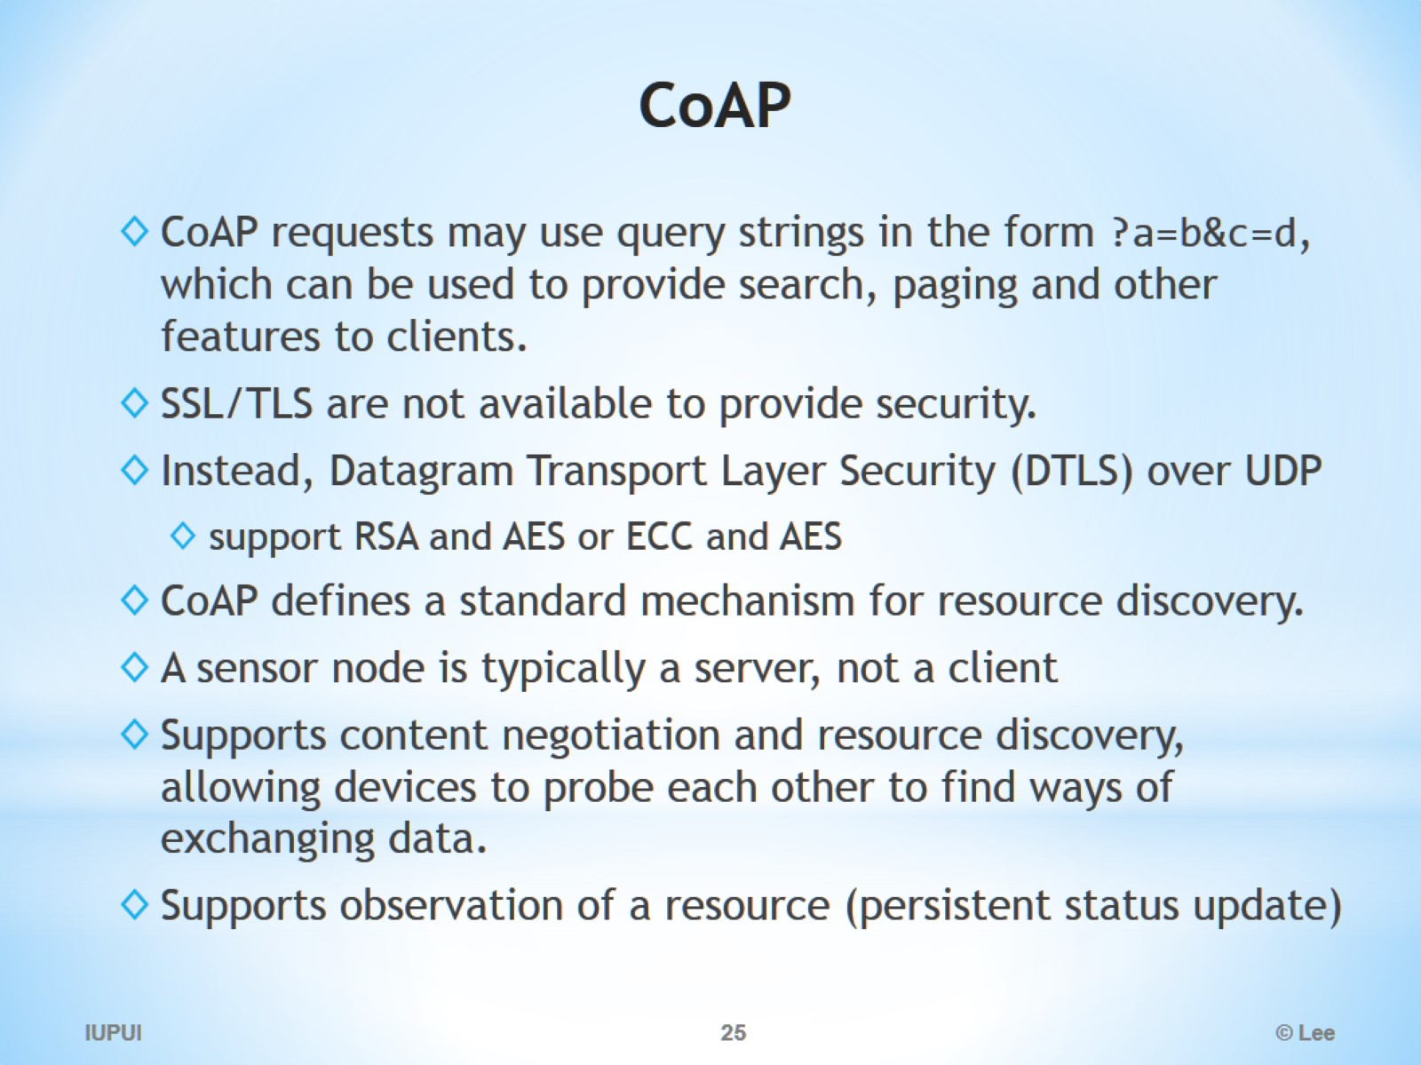
CoAP

Slide 26
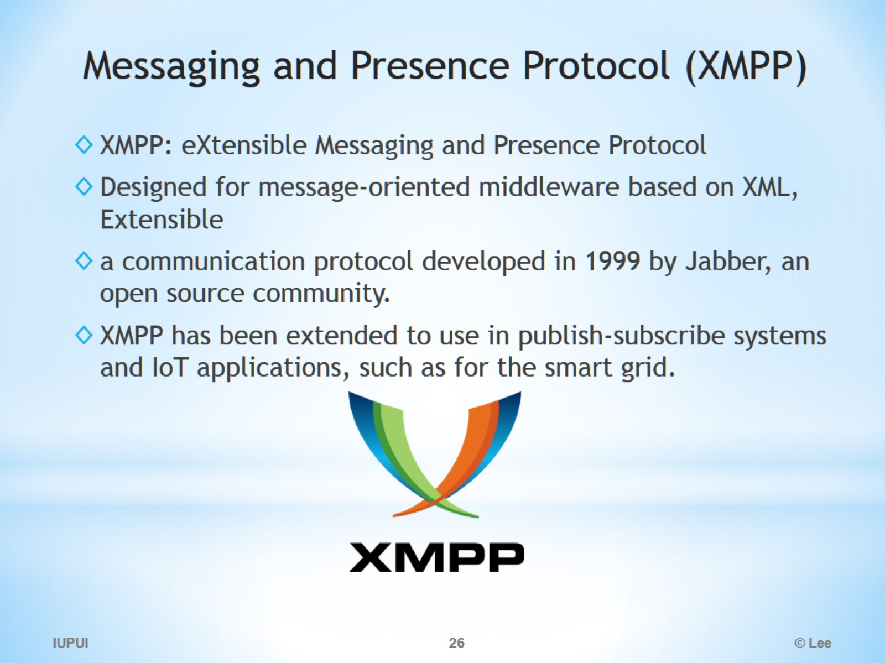
Messaging and Presence Protocol (XMPP)

Slide 27
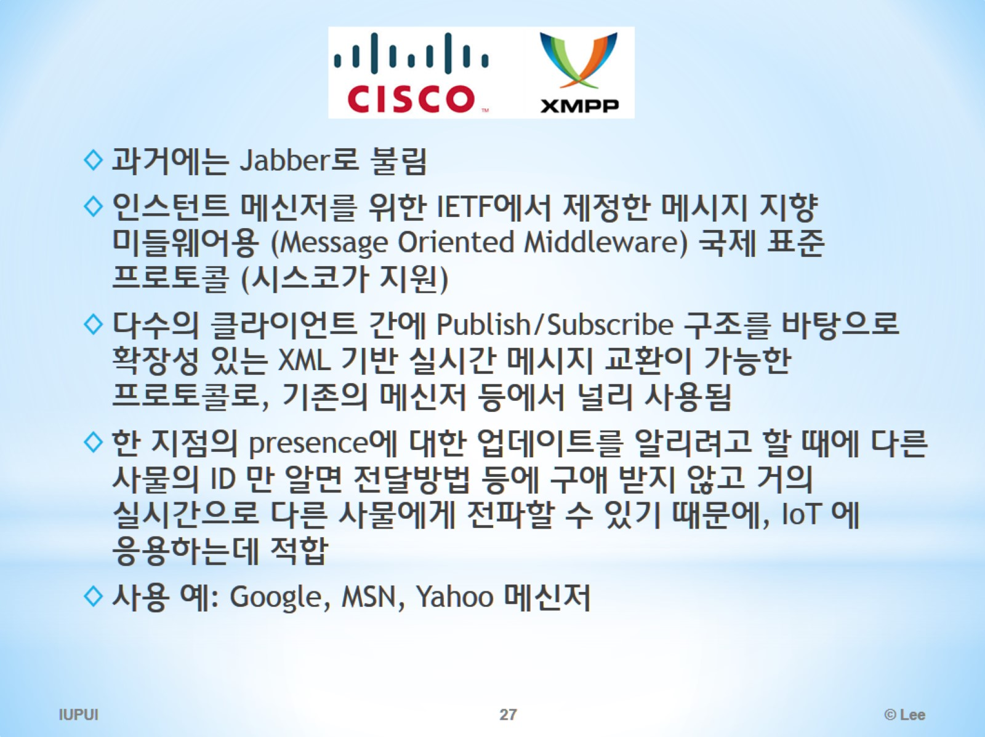
트ㅖㅖ

Slide 28
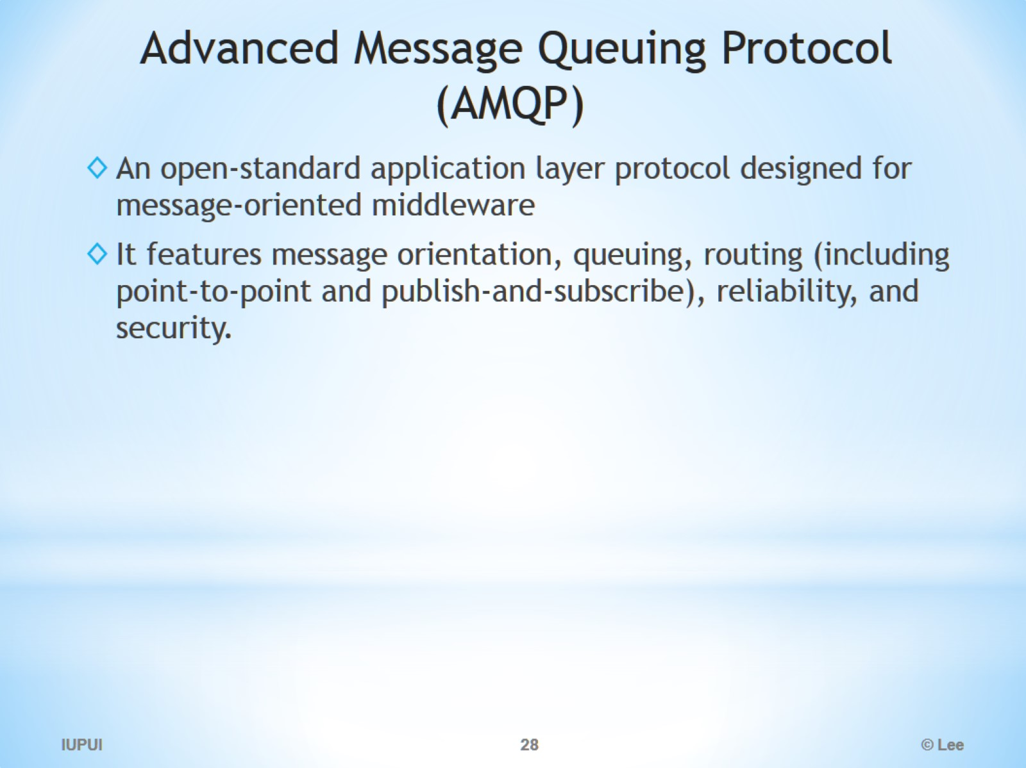
Advanced Message Queuing Protocol (AMQP)

